Slide 1
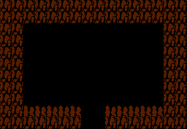
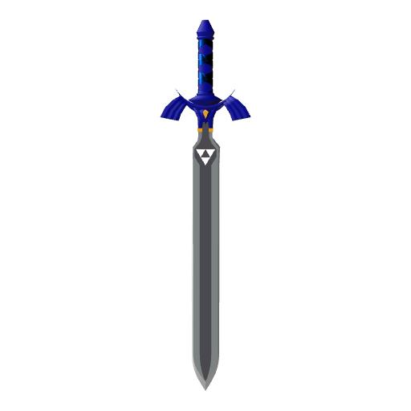
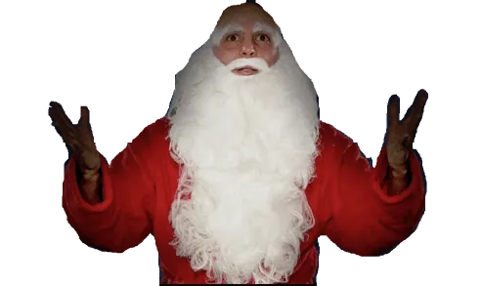
It’s not safe to go by yourself, do you want this?
Yes
No

Slide 2
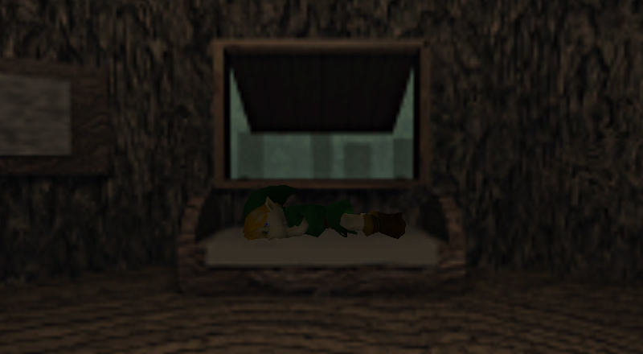
“Eh, someone else can save the world.”
You decide to go home and sleep.
Go back?

Slide 3
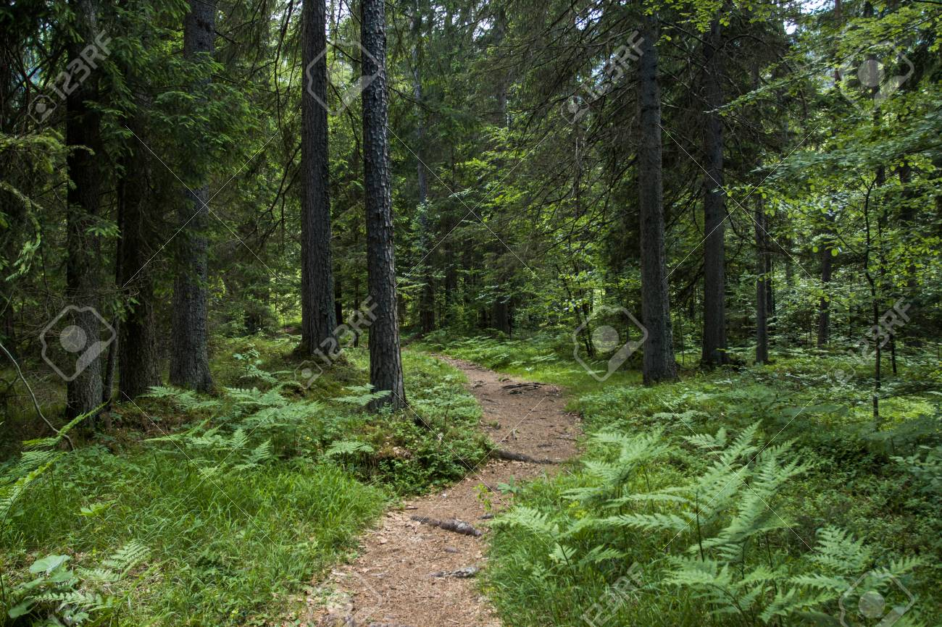
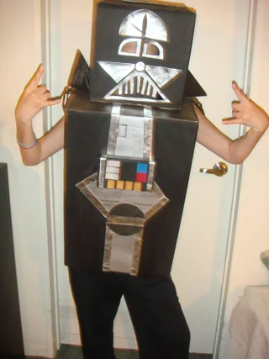
You begin to walk down the road, sword in hand, before a foe crosses your path!
Ay broski, the sword or your life.
Oof.
The sword doesn’t budge. Sad.
Continue?
Retrieve the sword and continue?
You want this sword? WELL THEN YOU CAN HAVE IT! (Stab him)

Slide 4
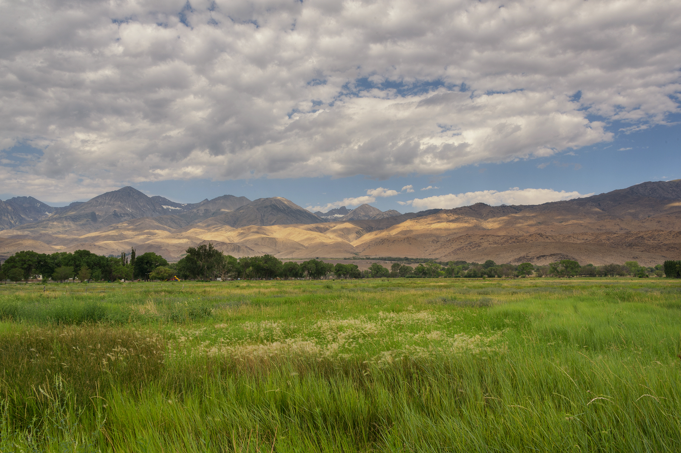
Wild Booser appears!
Run
Fight

Slide 5
There is no escape.
Fight

Slide 6
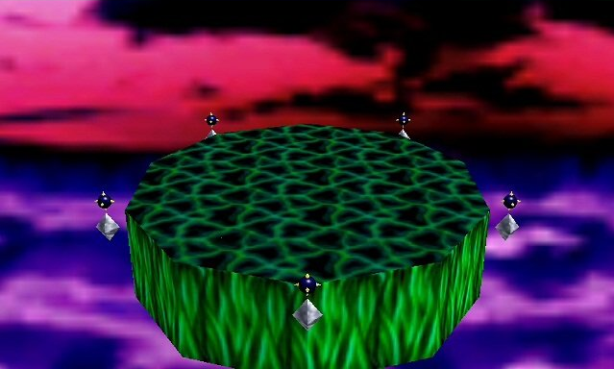
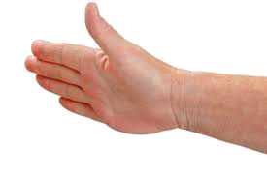
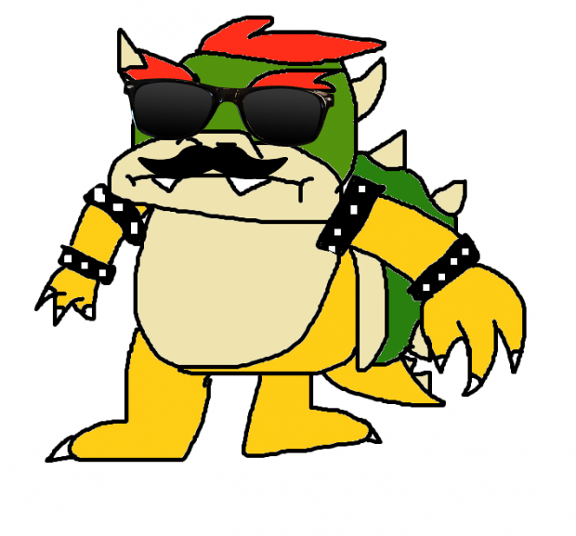
It is I, BOOSER™!!
SLAP
Continue?

Slide 7


You have defeated BOOSER!

Slide 8


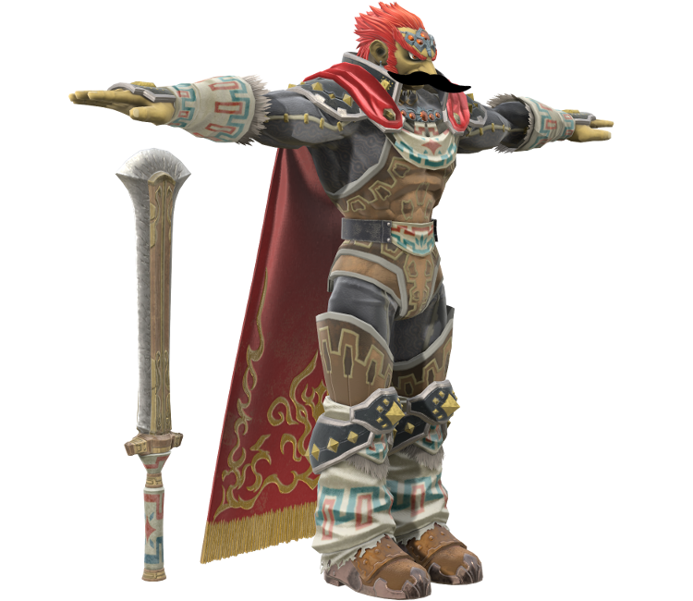

Ganondorf has come to end your life
STEP ON HIS TOES
Continue

Slide 9
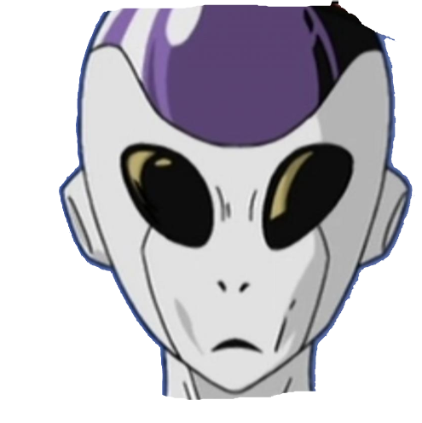
You have defeated Gorfnorf?

Slide 10
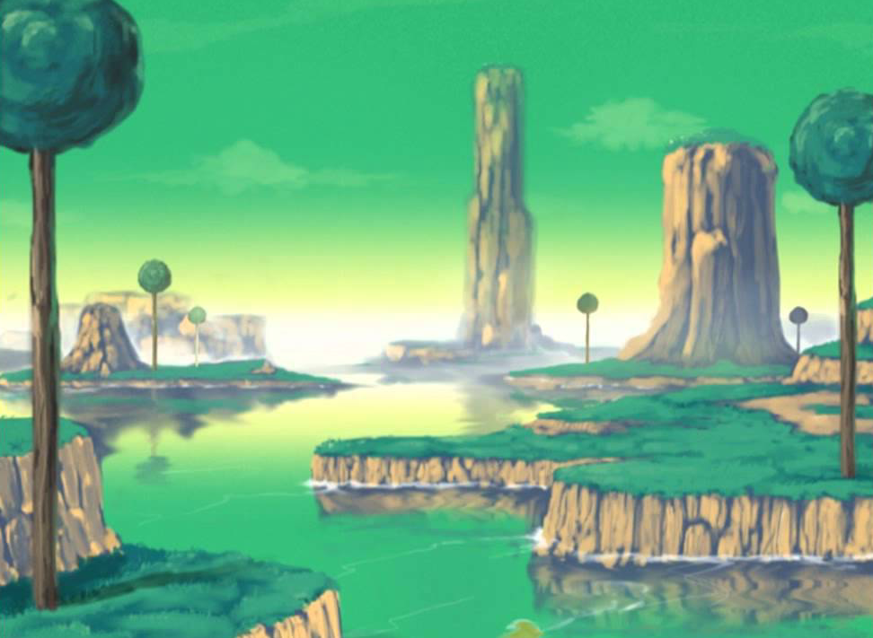
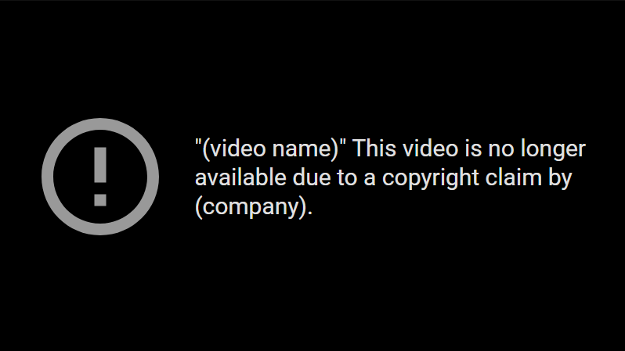

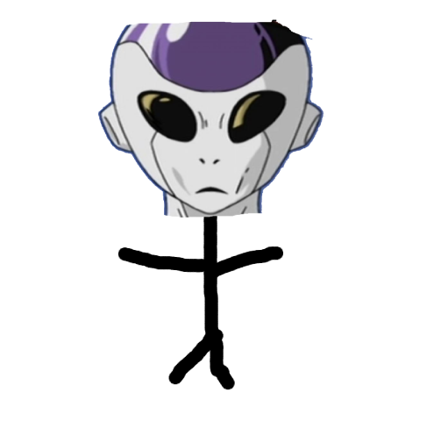

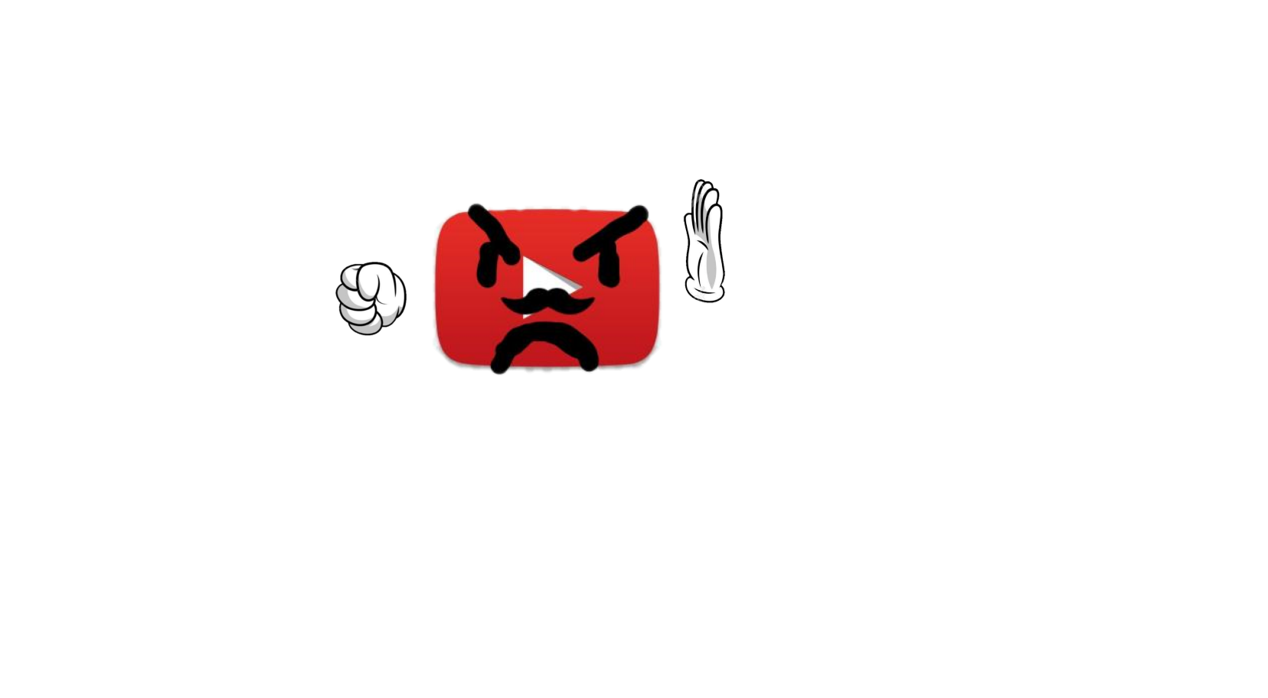

FOOSA WANTS REVENGE!
I heard someone was trying to make a living on content creation? NOT ON MY WATCH
Poke his eyeball?

Slide 11
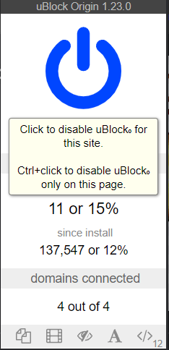
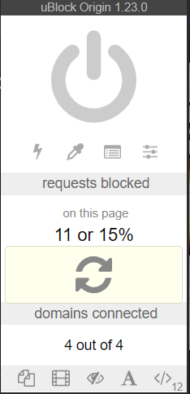

I heard someone was trying to make a living on content creation? NOT ON MY WATCH
The End?

Slide 12

Guys?
I’m here to help guys!
CREDITS
Portal Game:
Omar
Boss Fights:
Connor
Poop Trilogy:
Robert

Slide 13
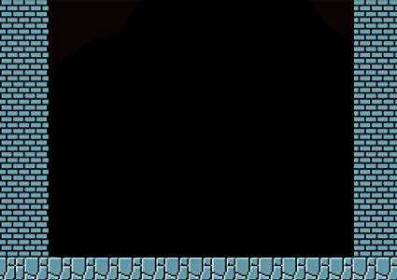

THE WARP ZONE
Boss 1 – Dark Vooder
Boss 2 – Booser
Boss 3 – Gorfnorf
Boss 4 – Foosa
Boss 5 – Yutwo

